Slide 1

Smart TAX
Automated Tax Filing with Document Processing and Smart Financial Analysis
Group ID - Y3S2-WE-PRO-03

Slide 2
Group Member Details
Student name | Registration number | Overall contribution
Kavishka P.K.P | IT19123332 | Document Management
Wickramaarachchi W.C.C | IT20093846 | User Management (CRUD for users)
Fathima Shamrina | IT19504100 | Tax Record Management
Warnakulasooriya H.M.G.L | IT21315800 | Payment & Subscription Management

Slide 3

Introduction
SmartTax simplifies tax filing, manages expenses, and automates financial reporting, ensuring accuracy and compliance.

Slide 4


Problems and Motivation
Challenges in tax filing:
Complexity
Time-consuming process
Manual errors
Lack of categorization
SmartTax provides an automated and efficient solution.

Slide 5





MySql
Database
Tools and Management
Node JS
Back – End developing
development
environment
React JS
Front – End developing
Source code management,
team collaboration and
version control manage

Slide 6

System Functions
User Authentication
Tax recode Management
Document Management
Financial Management
Payment & Subscription Management

Slide 7

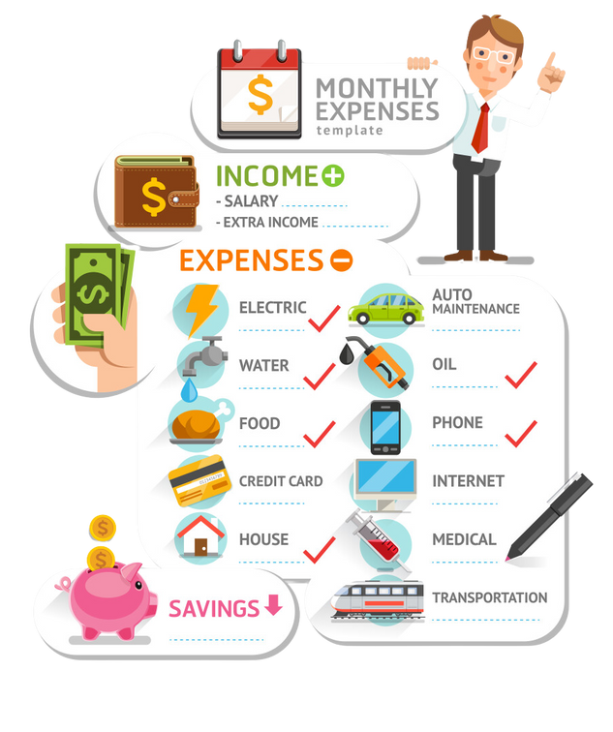
Novelty Function
Implementing a Newly Introduced Expense Categorization.

Slide 8
Document Management
Generate Documents
View Financial Data
Edit Financial Data
Remove unnecessary Data
Kavishka PKP
IT19123332
Expense Categorization
Users add new expenses and assign them to categories (e.g., Business, Medical, Education, Donations).
Users can view categorized expenses with filters (e.g., by date, category, or amount).
Users can edit expense details, change categories, or add receipts.
Users can remove incorrect or outdated expenses.

Slide 9
User Management
(CRUD for users)
Create new users (registration)
Read user details (profile view)
Update user info (edit profile)
Delete user accounts
Wickramaarachchi W.C.C
IT20093846
Notes:
Good afternoon thank u for this opportunity. I am Wickramaarachchi W.C.C. my contribution in this project is develop a user management system.So my part has mainly crud functions they are…

Slide 10
Tax Record Management (CRUD for tax filings)
Create new tax records
Read submitted tax filings
Update existing tax records
Delete tax records if necessary
Fathima Shamrina
IT19504100

Slide 11
Payment & Subscription Management (CRUD for payments)
Create new payment records (e.g., subscription plans, one-time fees)
Read payment history and invoices
Update payment details (e.g., change subscription, update billing info)
Delete expired or canceled subscriptions
Warnakulasooriya H.M.G.L
IT21315800

Slide 12
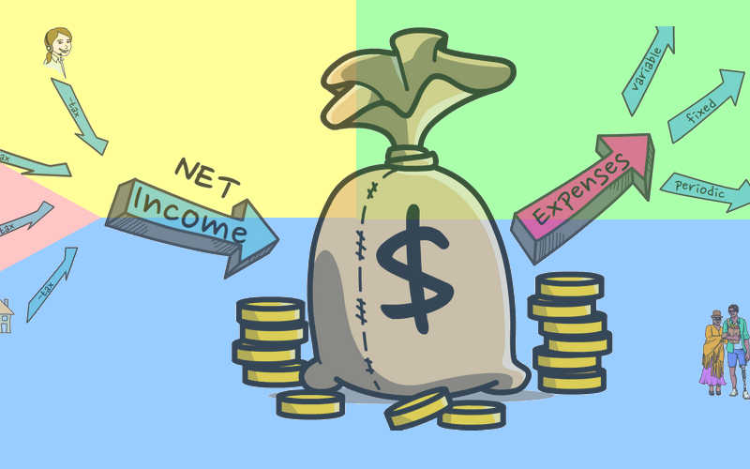
Thank
You!

